Slide 1

Using Objects

Slide 2
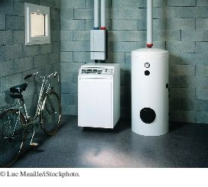
Objects and Classes
Each part a home builder uses, such as a furnace or a water heater, fulfills a particular function. Similarly, you build programs from objects, each of which has a particular behavior.
In Java, you build programs for objects.
Each object has certain properties/characteristics/data and behaviors/methods.
You can manipulate the object to get certain effects.

Slide 3
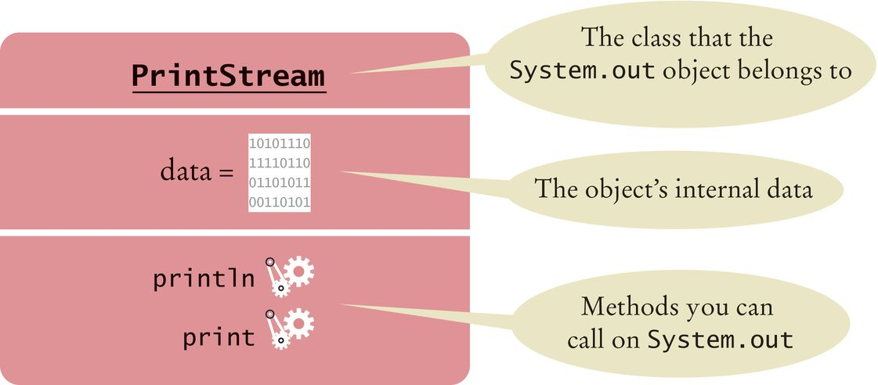
Using Objects
Object: an entity in your program that you can manipulate by calling one or more of its methods.
Method: consists of a sequence of instructions that can access the data of an object.
As a user, you do not know what the instructions are You do know that the behavior is well defined
For instance, System.out has a println method
You do not know how it works
What important is that it does the work you request of it
Figure 1 Representation of the System.out Object

Slide 4
Classes
A class describes a set of objects with the same behavior (Blueprint).
For instance, following are some objects of the String class:
"Hello World" "Goodbye" "Mississippi"
You can invoke the same methods on all strings.
System.out is a member of the PrintStream class that writes to the console window.
You can construct other objects of PrintStream class that write to different destinations.
All PrintStream objects have methods println and print.
Objects of the PrintStream class have a completely different behavior than the objects of the String class.
Different classes have different responsibilities
A string knows about the letters that it contains
A string doesn't know how to send itself to a console window or file.

Slide 5
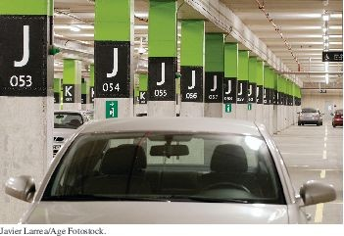
Variables
Use a variable to store a value that you want to use later To declare a variable named width
int width = 20;
Type
Name
Value
Like a variable in a computer program, a parking space has an identifier and a contents.

Slide 6
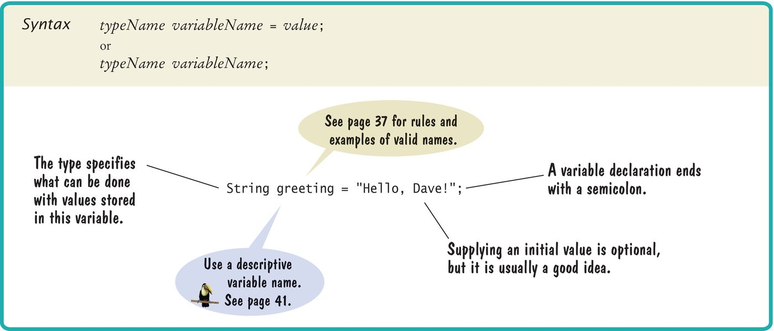
Variable Declaration

Slide 7
Types
Use the int type for numbers that cannot have a fractional part.
int width = 20;
Use the double type for floating point numbers.
double milesPerGallon = 22.5;
Numbers can be combined by arithmetic operators such as +, -, and *
Another type is String
String greeting = "Hello";
A type specifies the operations that can be carried out with its values.
You can multiply the value width by a number
You can not multiply greeting by a number.

Slide 8
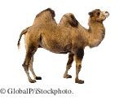
Names
Pick a name for a variable that describes its purpose. Rules for the names of variables, methods, and classes:
Must start with a letter or the underscore (_) character, and the remaining characters must be letters, numbers, or underscores.
Cannot use other symbols such as ? or % or a space
Use uppercase letters to denote word boundaries, as in milesPerGallon. (Called camel case)
Names are case sensitive
You cannot use reserved words such as double or class
By Java convention:
Variable names start with a lowercase letter. Class names start with an uppercase letter.

Slide 9
Comments
Use comments to add explanations for humans who read your code.
double milesPerGallon = 33.8;
// The average fuel efficiency of new U.S. cars in 2011
The compiler does not process comments
It ignores everything from a // delimiter to the end of the line.
For longer comment, enclose it between /* and */ delimiters.
The compiler ignores these delimiters and everything in between.
Example of longer comments
/*
In most countries, fuel efficiency is measured in liters per hundred kilometer. Perhaps that is more useful—it tells you how much gas you need to purchase to drive a given distance. Here is the conversion formula.
*/
double fuelEfficiency = 235.214583 / milesPerGallon;

Slide 10

Assignment
Use the assignment operator (=) to change the value of a variable.
You have the following variable declaration
int width = 10;
To change the value of the variable, assign the new value
width = 20;

Slide 11

Assignment
It is an error to use a variable that has never had a value assigned to it:
int height;
int width = height; // ERROR - uninitialized variable height
The compiler will complain about an "uninitialized variable"
Remedy: assign a value to the variable before you use it.
int height = 20;
int width = height; // OK
All variables must be initialized before you access them.

Slide 12
Calling Methods
You use an object by calling its methods.
All objects of a given class share a common set of methods.
The PrintStream class provides methods for its objects such as:
println print
The String class provides methods that you can apply to all String
objects.
Example: length
String greeting = “Hello, World!”;
int numberOfCharacters = greeting.length();
Example: toUpperCase
String river = “Mississippi”;
river = river.toUpperCase();

Slide 13

The Public Interface of a Class
The controls of a car form its public interface.
The private implementation is under the hood.
The String class declares many other methods besides the length and
toUpperCase methods.
Collectively, the methods form the public interface of the class.
The public interface of a class specifies what you can do with its objects. The hidden implementation describes how these actions are carried out.

Slide 14
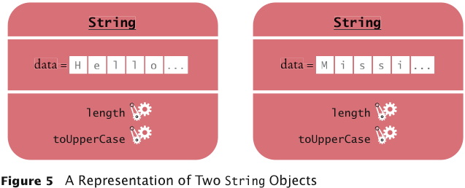
A Representation of Two String Objects
Each String object stores its own data.
Both objects support the same set of methods.
Those methods form the public interface
Public interface is specified by the String class.

Slide 15
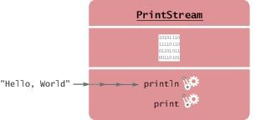
Method Arguments
Most methods require values that give details about the work that the method needs to do.
You must supply the string that should be printed when you call the println method.
The technical term for method inputs is arguments.
The string greeting is an argument of this method call:
System.out.println(greeting);
Passing an Argument to the println Method

Slide 16
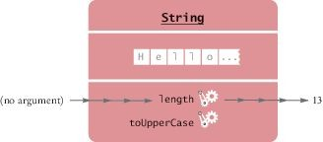
Method Arguments
Some methods require multiple arguments.
Some methods don't require any arguments at all.
Example: the length method of the String class
All the information that the length method requires to do its job is stored in the object
Invoking the length Method on a String Object

Slide 17
Return Values
Some methods carry out an action for you.
Example: println method
Some methods compute and return a value.
Example: the String length method
returns a value: the number of characters in the string.
You can store the return value in a variable:
int numberOfCharacters = greeting.length()
The return value of a method is a result that the method has computed.

Slide 18
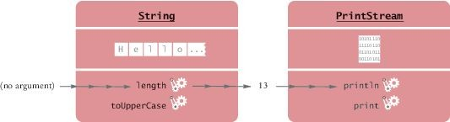
Return Values
You can also use the return value of one method as an argument of another method:
System.out.println(greeting.length());
The method call greeting.length() returns a value - the integer 13. The return value becomes an argument of the println method.
Passing the Result of a Method Call to Another Method

Slide 19
Return Values - replace method
Example: assume String river = "Mississippi";
Then the statement
river = river.replace("issipp", "our");
Constructs a new String by
Replacing all occurrences of "issipp" in"Mississippi" with "our"
Returns the constructed String object "Missouri" And saves the return value in the same variable
You could pass the return value to another method:
System.out.println(river.replace("issipp", "our"))

Slide 20
Method Declaration
To declare a method in a class, specify
The types of the arguments The return value
Example: public int length()
There are no arguments
The return value has the type int
Example: public String replace(String target, String replacement)
Has two arguments, target and replacement
Both arguments have type String
The returned value is another string
Example: public void println(String
Has an argument of type String
No return value
Uses the keyword void
output)

Slide 21
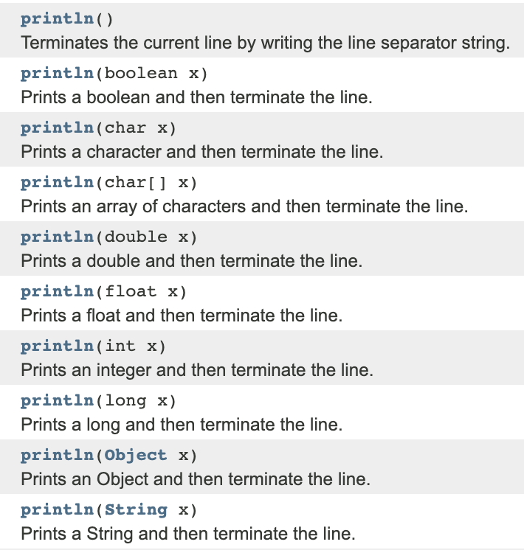
Method Declaration
A class can declare two methods with the same name and different argument types.
The PrintStream class declares another println method
public void println(int output)
Used to print an integer value
The println name is overloaded because it refers to more than one method.

Slide 22

Constructing Objects
Objects of the Rectangle class describe rectangular shapes.

Slide 23
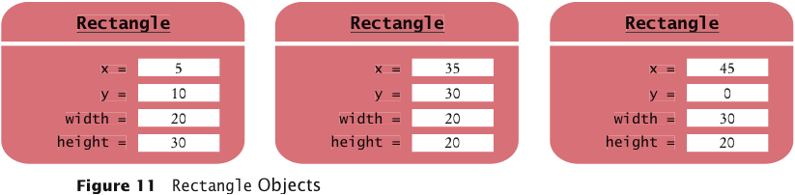
Constructing Objects
The Rectangle object is an object that contains a set of numbers.
The numbers describe the rectangle
Each rectangle is described by:
The x- and y-coordinates of its top-left corner, its width and height.
In the computer, a Rectangle object is a block of memory that holds four numbers.

Slide 24
Constructing Objects
Use the new operator, followed by a class name and arguments, to construct new objects.
new Rectangle(5, 10, 20, 30)
Detail:
The new operator makes a Rectangle object
It uses the parameters (in this case, 5, 10, 20, and 30) to initialize the data of the object
It returns the object
The process of creating a new object is called construction.
The four values 5, 10, 20, and 30 are called the construction arguments. Usually the output of the new operator is stored in a variable:
Rectangle box = new Rectangle(5, 10, 20, 30);
Additional constructor
new Rectangle()

Slide 25
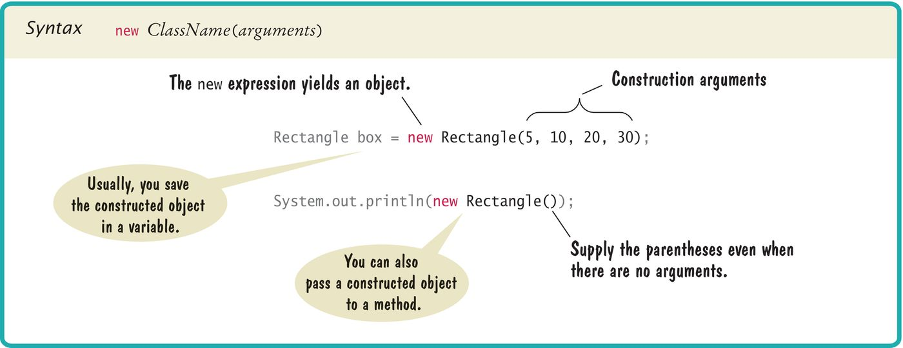
Syntax 2.3 Object Construction

Slide 26
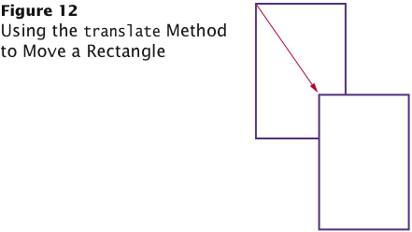
Accessor and Mutator Methods
Accessor method: does not change the internal data of the object on which it is invoked.
Returns information about the object
Example: length method of the String class Example: double width = box.getWidth();
Mutator method: changes the data of the object
box.translate(15, 25);
The top-left corner is now at (20, 35).

Slide 27
Self Check
What does this sequence of statements print?
Rectangle box = new Rectangle(5, 10, 20, 30); System.out.println("Before: " + box.getX()); box.translate(25, 40); System.out.println("After: " + box.getX());
Answer:
Before: 5
After: 30

Slide 28
Self Check
What does this sequence of statements print?
Rectangle box = new Rectangle(5, 10, 20, 30); System.out.println("Before: " + box.getWidth()); box.translate(25, 40); System.out.println("After: " + box.getWidth());
Answer:
Before: 20
After: 20
Moving the rectangle does not affect its width or height. You can change the width and height with the setSize method.

Slide 29
Self Check
What does this sequence of statements print?
String greeting = "Hello"; System.out.println(greeting);
System.out.println(greeting.toUpperCase()); System.out.println(greeting);
Answer:
Hello
HELLO
Hello
Note that calling toUpperCase doesn't modify the string.

Slide 30
Self Check
Is the toUpperCase method of the String class an accessor or a mutator?
Answer: An accessor — it doesn't modify the original string but returns a new string with uppercase letters.

Slide 31
Packages
Java classes are grouped into packages.
The Rectangle class belongs to the package java.awt. To use the Rectangle class you must import the package:
import java.awt.Rectangle;
Put the line at the top of your program.
You don't need to import classes in the java.lang package such as
String and System.

Slide 32
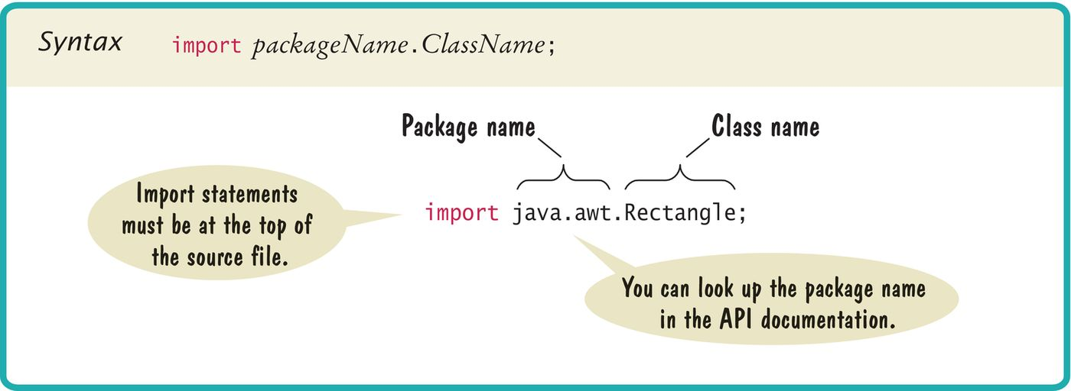
Syntax 2.4 Importing a Class from a Package

Slide 33
Self Check
The Random class is declared in the java.util package. What do you need to do in order to use that class in your program?
Answer: Add the statement
import java.util.Random;
at the top of your program.

Slide 34
Implementing a Test Program
A test program verifies that methods behave as expected. Steps in writing a tester class
Provide a tester class.
Supply a main method.
Inside the main method, construct one or more objects.
Apply methods to the objects.
Display the results of the method calls.
Display the values that you expect to get.

Slide 35
Implementing a Test Program
Code to test the behavior of the translate method
Rectangle box = new Rectangle(5, 10, 20, 30);
// Move the rectangle box.translate(15, 25);
// Print information about the moved rectangle System.out.print("x: "); System.out.println(box.getX()); System.out.println("Expected: 20");
Place the code inside the main method of the MoveTester class Determining the expected result in advance is an important part of testing.

Slide 36
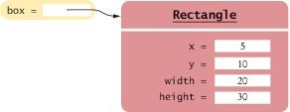
Object References
An object variable is a variable whose type is a class
Does not actually hold an object.
Holds the memory location of an object
An Object Variable Containing an Object Reference
Object reference: describes the location of an object After this statement:
Rectangle box = new Rectangle(5, 10, 20, 30);
Variable box refers to the Rectangle object returned by the new operator The box variable does not contain the object. It refers to the object.

Slide 37
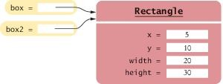
Object References
Multiple object variables can refer to the same object:
Rectangle box = new Rectangle(5, 10, 20, 30); Rectangle box2 = box;
Two Object Variables Referring to the Same Object

Slide 38
Numbers
Numbers are not objects.
Number variables actually store numbers.
A Number Variable Stores a Number

Slide 39
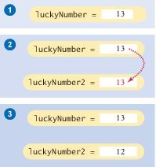
Copying Numbers
When you copy a number
the original and the copy of the number are independent values.
int luckyNumber = 13;
int luckyNumber2 = luckyNumber; luckyNumber2 = 12;
Copying Numbers

Slide 40
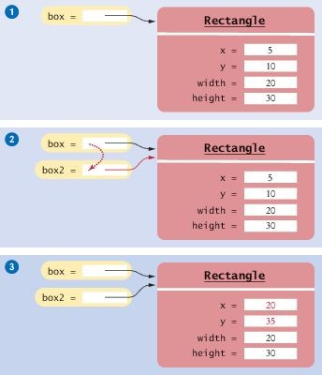
Copying Object References
When you copy an object reference
both the original and the copy are references to the same object
Rectangle box = new Rectangle(5, 10, 20, 30); Rectangle box2 = box;
box2.translate(15, 25);
Copying Object References

